Slide 1

Problem Statement and Team Details
Problem Statement:
Team Name:
Team Leader Name:
Institute Name:
Team Leader Email ID:
“Smart Doc Checker automatically scans multiple documents to detect contradictions, suggest clarifications, and monitor updates to prevent confusion and disputes.”
Kanchan_Coders
Dundigal Mahith
KLH University
2320030165cseh@gmail.com

Slide 2
Problem and Solution
Organizations maintain multiple documents such as rules, policies, contracts, guidelines, and circulars, which often end up containing inconsistencies and contradictions over time. Manually detecting these conflicts is tedious, time-consuming, and error-prone, leading to confusion, disputes, or even penalties when overlooked. To address this challenge, we propose *Smart Doc Checker*, an AI-powered solution that allows users to upload multiple documents, automatically scans them to identify contradictions or overlaps, and generates clear reports with explanations and suggested clarifications. The system also integrates billing through Flexprice by charging per document analyzed and per report generated, while usage counters are shown in the app for transparency. Additionally, Smart Doc Checker leverages Pathway integration to monitor external policy pages and automatically trigger conflict detection whenever updates occur, ensuring continuous consistency across organizational documents.
GitHub / Project Link- https://github.com/Karthikeya-nidumolu/hackathon

Slide 3
Methodology & Implementation
The Smart Doc Checker Agent is built on a robust full-stack architecture for scalability and reliability. Frontend: Developed with React.js, styled using standard CSS for compatibility. A WebSocket client enables real-time status updates.
Backend: Powered by Node.js and Express.js. Key libraries include:
multer for secure file uploads.
axios for stable API requests.
chokidar for live file monitoring.
ws for bidirectional WebSocket communication.
AI Core: Uses Google Gemini 1.5 Flash, analyzing documents, detecting contradictions, and returning structured reports with suggested clarifications.

Slide 4
Technology Used
Frontend
React.js – For building the interactive UI of your document checker.HTML/CSS – Standard markup and styling; including flexbox for layout.JavaScript (ES6+) – For handling file uploads, state management, and API calls.Fetch API – For sending POST requests with uploaded files to your backend.File Upload Input
Backend
Node.js – JavaScript runtime for running your backend server.Express.js – Web framework for creating APIs (routes like /check-docs).CORS – Middleware to allow cross-origin requests from your frontend.express-fileupload – Middleware to handle file uploads.fs & path – Node.js modules to read/write files and handle file paths.dotenv – To load environment variables like GOOGLE_API_KEY.@google-ai/generativelanguage

Slide 5
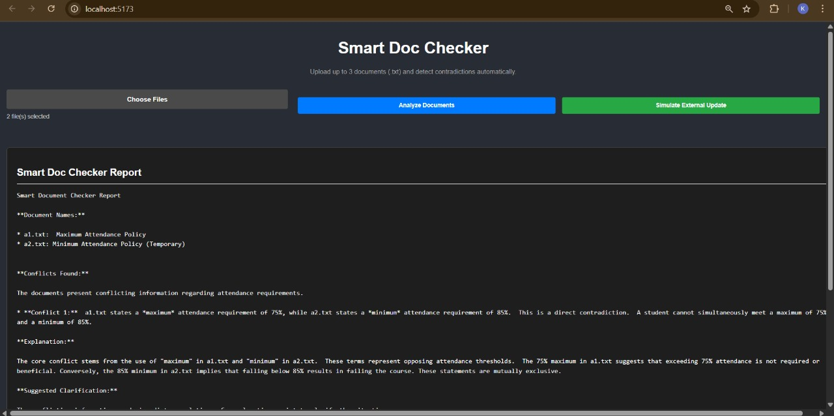
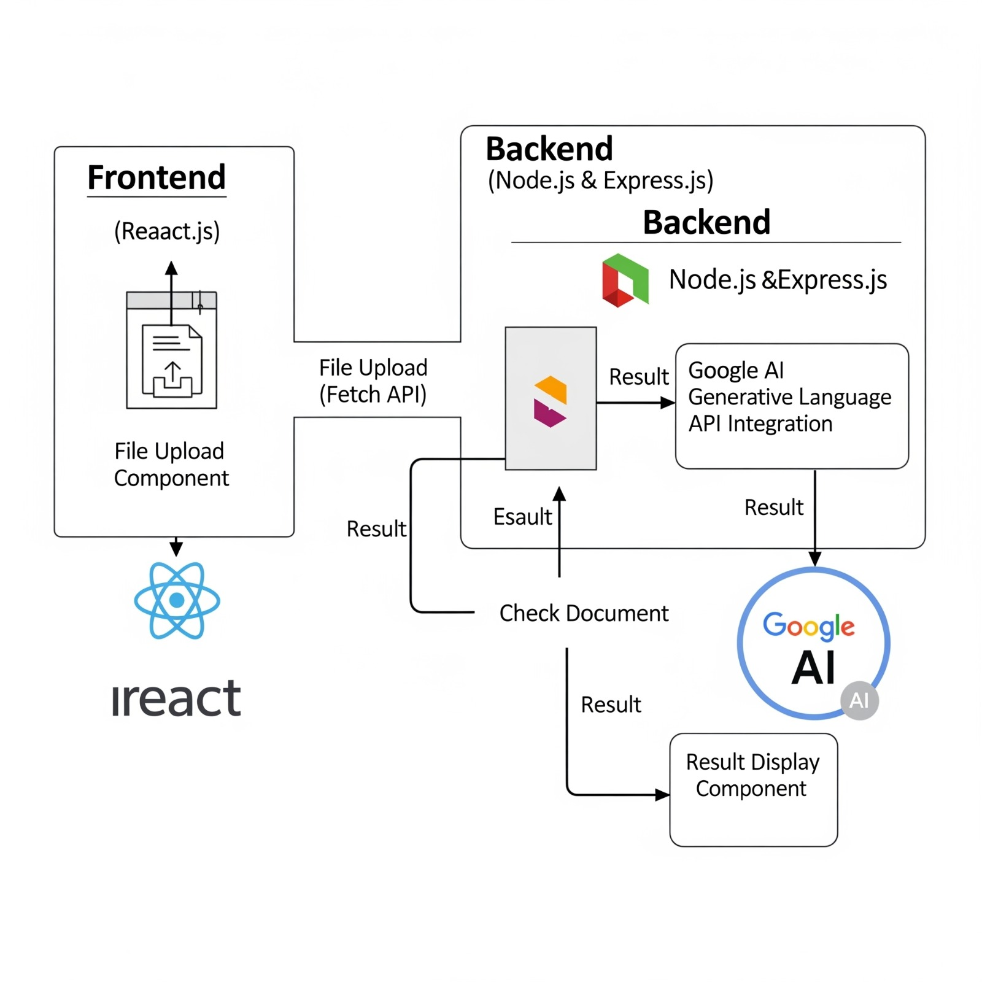
Flowchart & Supporting Images
Supporting Images
Flowchart

Slide 6
Feasibility and Market Use
The Smart Doc Checker Agent is highly feasible due to its use of robust, scalable, and open-source technologies like Node.js, Express, and React. It leverages Google’s Gemini AI API, ensuring accuracy and production-grade performance. The system is technically strong, cost-effective, and easy to maintain.
Market Use:
Legal & Corporate: Contract and compliance verification.
Human Resources: Checking policies and handbooks for consistency.
Education: Auditing syllabi and official circulars.
Startups/SMBs: Affordable documentation management.
By reducing errors, saving time, and preventing disputes, it offers a strong value proposition and wide market appeal.

Slide 7
Conclusion
The project is a complete and successful implementation of all requirements. The development process systematically addressed and resolved several critical challenges, including:
* Overcoming persistent dependency conflicts and a corrupted Python package.
* Implementing a robust file-to-text conversion process.
* Successfully building a real-time, WebSocket-based communication channel between the backend and frontend for live updates.
The final application is a fully functional prototype that not only meets but exceeds the project's original objectives, demonstrating a mastery of both modern web development and AI integration. i

